Slide 1

Maritime Trade Share Estimation
Bessie Bao, Joanna Wang

Slide 2
Content
Dataset Required and Adjustment
Trade Costs, CO2, and the Environment (Shapiro)
Dataset Required and Adjustment
Trade-Linked Shipping CO2 Emission (Wang)
Methodology When no Data (marine transport proportion) Available

Slide 3
Data Sources & Adjustment (Specific dataset) --Shapiro
US Imports and Exports of Merchandise (US air and sea) | US import: sum freight charges and product values to obtain the goods value
North American Freight (US truck and train)
Trade Statistics of Japan (Japan) | Only distinguishes transport mode for airborne and container ship trade, so assign additional Japanese trade values (obtained from the same Trade Statistics of Japan source) to sea shipment
Global Trade Atlas compiled by Global Trade Information (China)
EU Secretariat (external trade is publicly available and internal trade obtained by request) | treat inland waterway trade as maritime trade
Latin America Integration Association (ALADI, for Argentina, Bolivia, Brazil, Chile, Columbia, Ecuador, Paraguay, Peru, Uruguay, and Venezuela)

Slide 4
Data Sources & Adjustment (General) --Shapiro
Exclude observations with unknown trading partners or products
Convert all foreign currencies to US dollars using the mean period exchange rate from the IMF's International Financial Statistics
Deflate values to the year 2007 using the US Bureau of Labor Statistics Consumer Price Index
Use importer reports whenever possible
When a trade flow reports currency but not weight, impute weight using the mode-specific weight-to-value ratio from all other countries reporting transportation modes.
Group unknown, post, pipeline, and self-propulsion transportation modes into one “other” category
If a landlocked country reports trade by sea, measure the sea distance according to the population-weighted distance from its trading partner.
Cover 83% of international trade by value and 74% of global trade by weight
Impute 17%-26% international transportation mode share

Slide 5
Data Sources & Adjustment (Direct) –Wang
Data Sources
Cover 68% of international trade volume
GTAP (2007) —based on United Nation (UN) Comtrade database | trade pairs related to some of the other countries
Eurostat database | EU countries
US census | trade import and export related to the US

Slide 6

Methodology
Seaborne Trade Proportion Estimation
Idea: ratio of LTII and the seaborne proportion (SP') of commodities pre-estimated by transoceanic countries (trades only by air and sea)
LTII - land transport infeasibility index ​
​
*possibility of land transportation of goods between trading partners based on the countries’ geographical locations and the land transport network.​
"Transportation mode depends on both the geographic location of the trading partners and the characteristics of products"
non-adjacent country pairs located on different continents or separated by ocean or land | 1
land-adjacent | 0.5
Intracontinental land-adjacent in Asia | 0.8
Intra-Europe trades | 0.3
Russia and European countries | 0.5
SPo,d,c: the seaborne proportion of commodity c exported from o to d.
SP′c: the seaborne proportion of commodity c

Slide 7
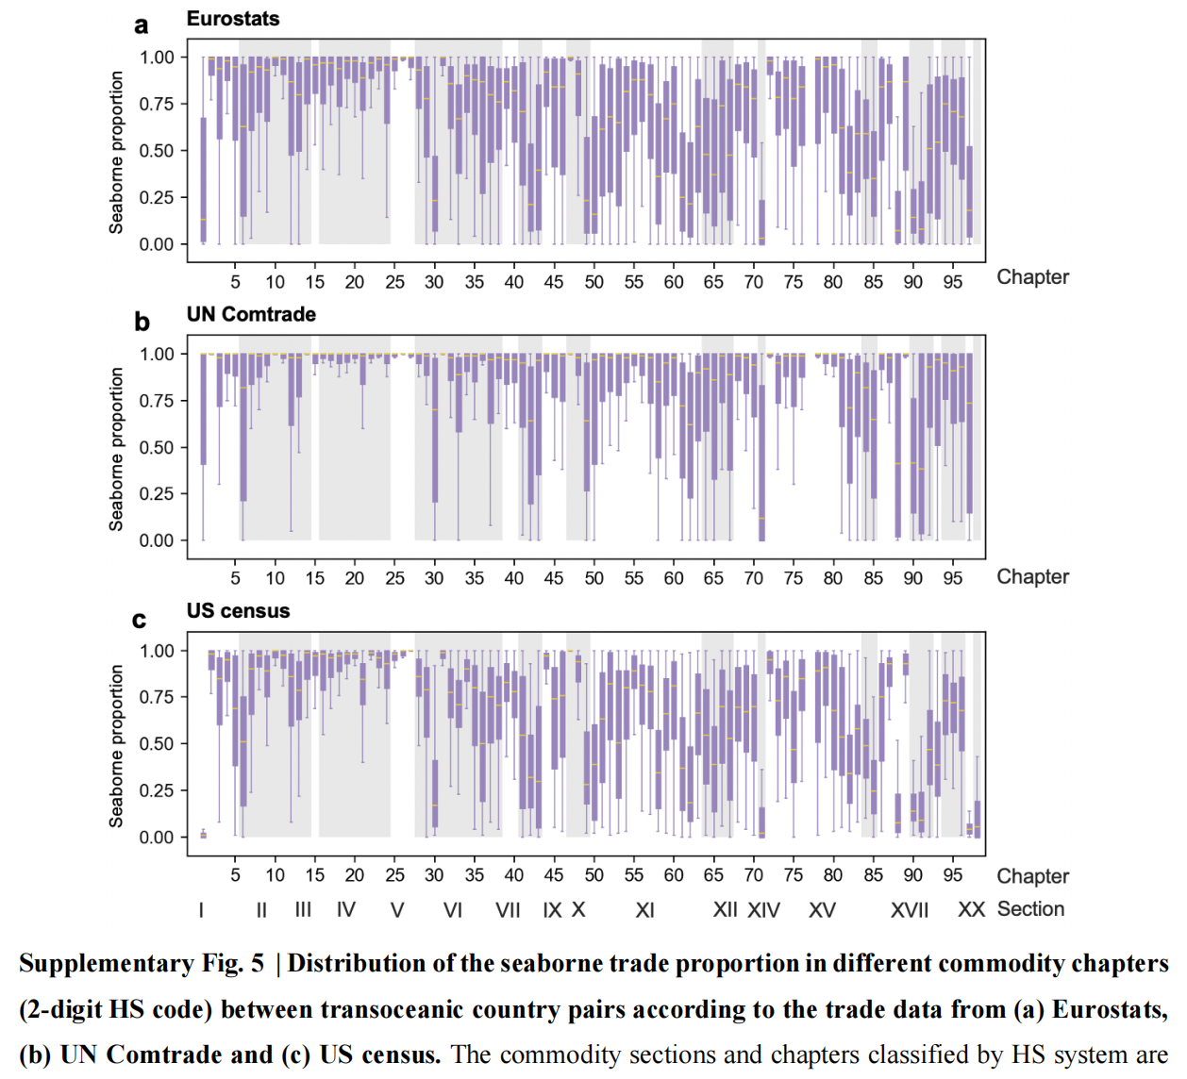
Methodology
SP' - Commodity characteristics
estimated by transoceanic countries (LTII = 1) based on available modal-split data.
sea transport | bulk goods with lower value and higher weight (bulkers) | HS 26 - ores HS 27 - mineral products HS 10 - cereals
Air transport | perishable goods | HS 01 - live animals
 | Precious commodities | HS 71 - precious metals HS 91- clocks and watches

